Slide 1
Mantid Release Presentation
Release 3.7
ISIS

Slide 2
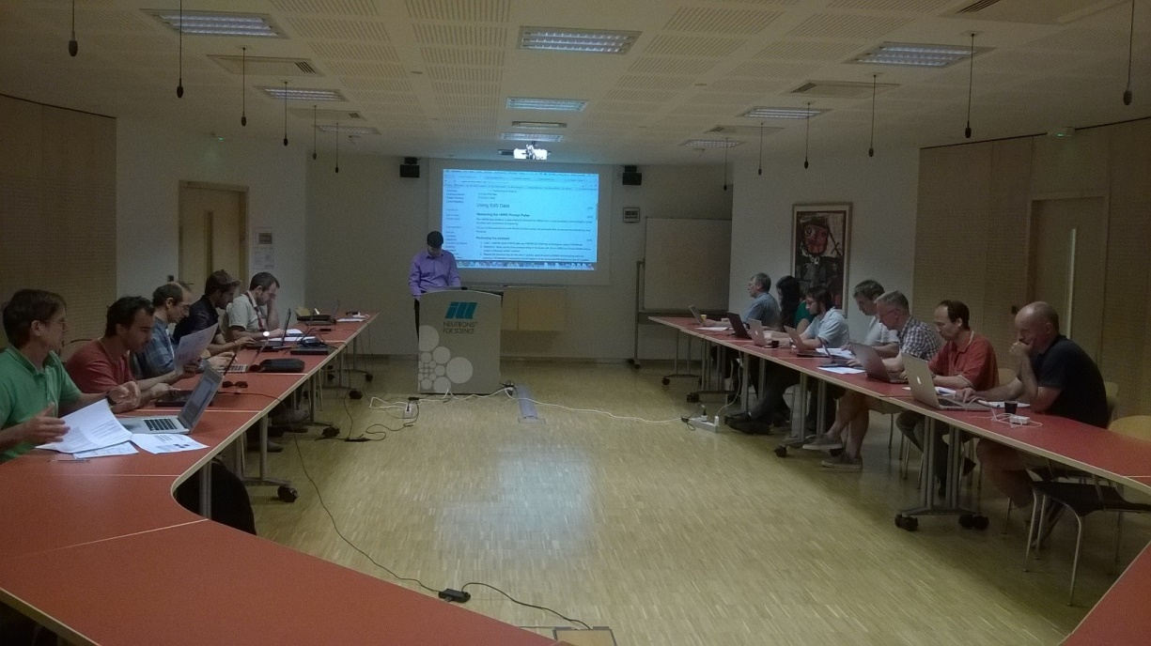
Training Courses
Dates
Last Course
April 2016
Next courses
?October 2016
To Book
Email: nick.draper@stfc.ac.uk
More details at www.mantidproject.org

Slide 3








Supported Platforms
Staying the same
RHEL 6 64bit
RHEL 7 64bit
OSX Mavericks +
Windows 7 64 bit
Ubuntu 14.04 64 bit
Limited support for
Windows 8 64 bit
Fedora 20
Windows 10

Slide 4
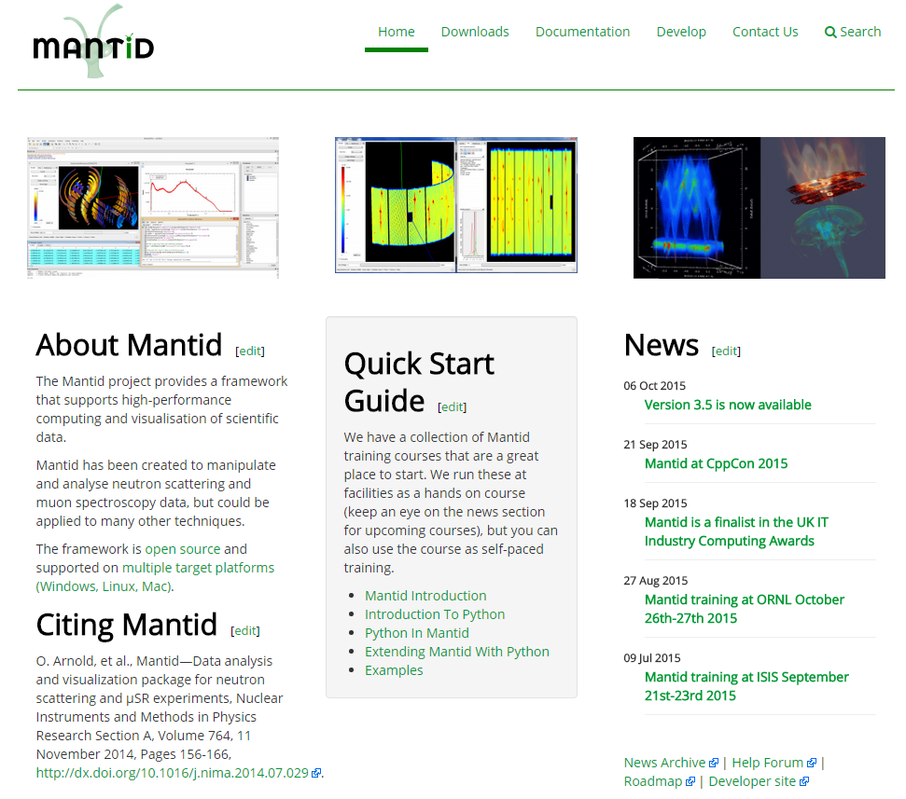
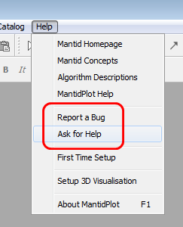
Mantid Support Forum
forum.mantidproject.org
help.mantidproject.org

Slide 5
Next Release
Release v3.8
Planned Release Date: 10th October 2016

Slide 6

Thank you

